Slide 1



Slide 2

College of Engineering, Chengannur
Internal Guide : Arathy U P
Department of Computer Science Engineering
Team Members
Gouri G Varma CHN20CS050
Merin Mary Shibu CHN20CS069
Abdulla S CHN20CS001
Abel Raju CHN20CS002

Slide 3
Introduction
The term “e-commerce” simply means the sale of goods or services on the internet.
Through an e-commerce website, a business can process orders, accept payments, manage shipping and logistics, and provide customer service.
We aim to develop an e-commerce website of the sort but which is mainly centered around college students and their academics.

Slide 4
Problem Definition
Students have always struggled in acquiring all the necessary textbooks for each semester.
Available books may only be available at high prices.
There are no convenient methods for students to acquire lecture notes.
Student-centered e-commerce websites are non existent.

Slide 5
Existing System
Students need to physically go to shops for buying academic books
Lecture notes and other study materials may not be easily available
Existing e-commerce websites are not student-friendly

Slide 6
Proposed System
This website facilitates selling or buying second hand books mainly focusing on study materials and lecture notes.
This provides a platform for students to get access to textbooks, notes etc. at cheap costs and on the flip side also allows them to earn money by selling their used books and self prepared notes.
This will allow senior students to help younger ones with their academics and course work.

Slide 7
Scope
The scope of the project is to provide an e-commerce website mainly focusing on student applications.
This website can be integrated into an android application in the future for ease of use.
This website can be further developed to include recommendation systems, messaging and renting facilities.

Slide 8
Requirements Specification
Software Requirements
Microsoft Visual Studio code
MongoDB
NodeJS
Hardware Requirements
Processor: AMD Ryzen 3
RAM: 8GB
Hard Disk: 128GB SATA

Slide 9
What we’ll build
E-Commerce Website
Frontend
(HTML, CSS, JS)
Backend
(Node, Express, MongoDB)
Customer Sites
Admin Sites

Slide 10
Views
Customer
Admin
Signup
Login
All Products
Dashboard
Product Details
Product Details
Shopping Cart
New Product
All Orders For Customers
Update Product
All Orders

Slide 11
Models
User
Email, password, isadmin, name, address
Product
Cart
Order
Name, summary, price, image, description
Items, total price, number of items
User data, products/cart data, date, status

Slide 12
Data Flow Diagrams
Level 0
Request for login Request for registration
ADMIN
Online
Books shopping
USER
Response Response

Slide 13
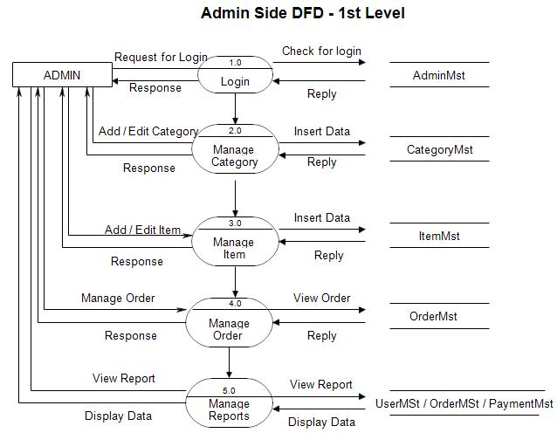
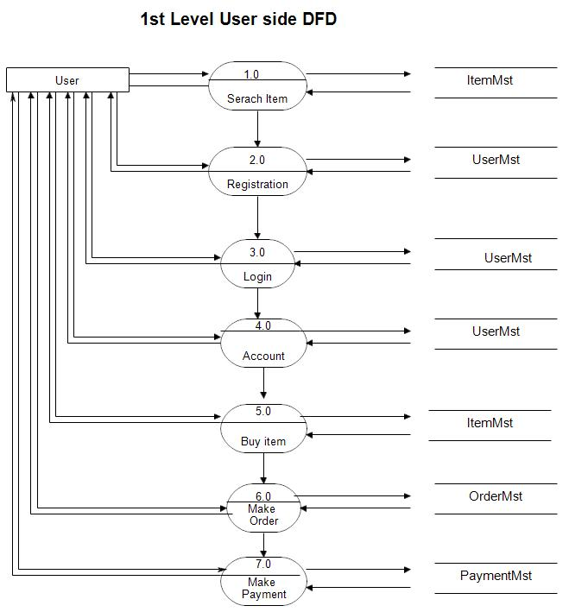
Level 1
request
Search for item
response
reply
request
Request for reg.
response
reply
request
Check for login
response
reply
request
Check for Account
response
reply
request
Request to buy
response
reply
request
Create order
response
reply
request
Make payment
response
reply

Slide 14
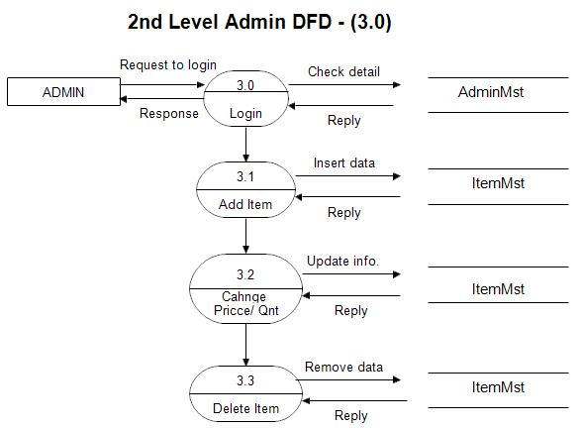
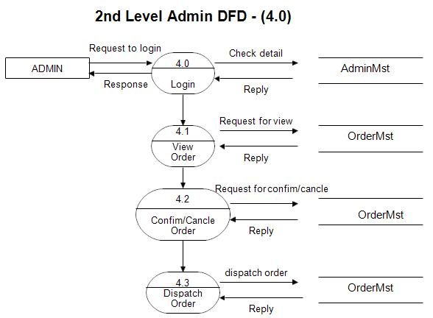
Level 2

Slide 15
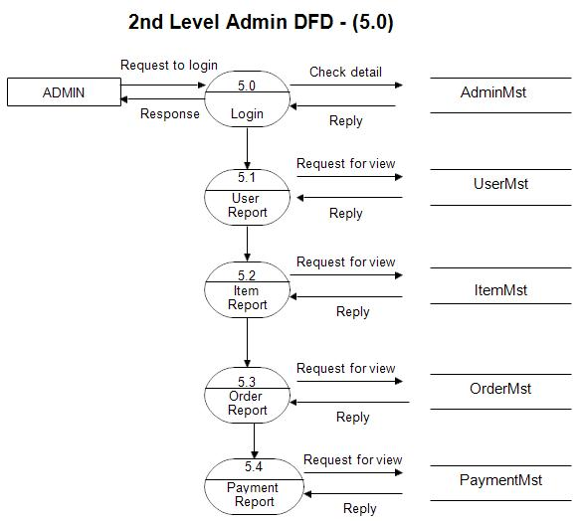

Slide 16
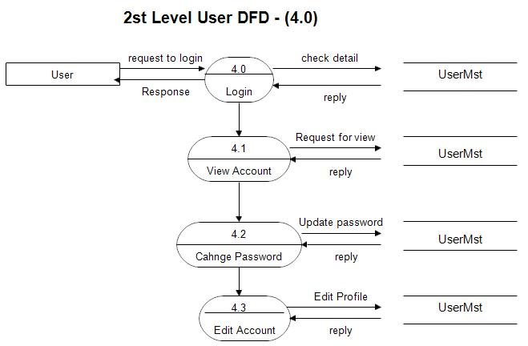
Level 2

Slide 17
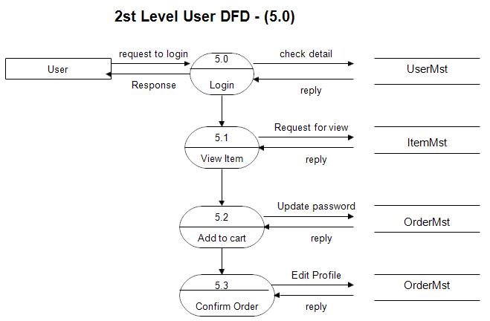

Slide 18
Conclusion
The e-commerce website for students enables students to better their academics by providing them ready access to books and study materials
The students will be provided with books, their price and reviews and recommendations posted by their peers
Students and retailers will be able to sell books and lecture notes

Slide 19
References
https://www.codewithrandom.com/2023/03/15/ecommerce-website-using-html-css-and-javascript-simple-and-responsive-ecommerce-website/
https://www.researchgate.net/publication/304703920_A_Review_Paper_on_E-Commerce
The applicable IEEE standards as published in ‘IEEE standards collection, for the preparation of SRS’.
Backup policy, Naming Conventions as per Teleparadigm Conventions

